Slide 1

IOT based smart wearable safety gadget
Group-7
Amandeep Kaur(748434)

Slide 2
Schematic design

Slide 3
Proteus ISIS
Well known simulation software.
Deals with number of electronic components and microcontrollers.
Open source.

Slide 4
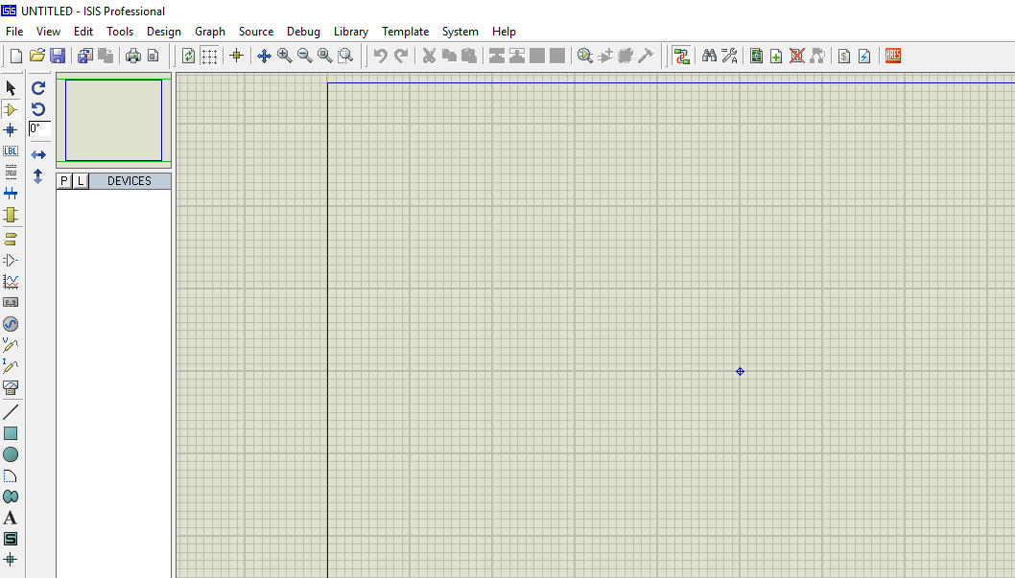

Slide 5
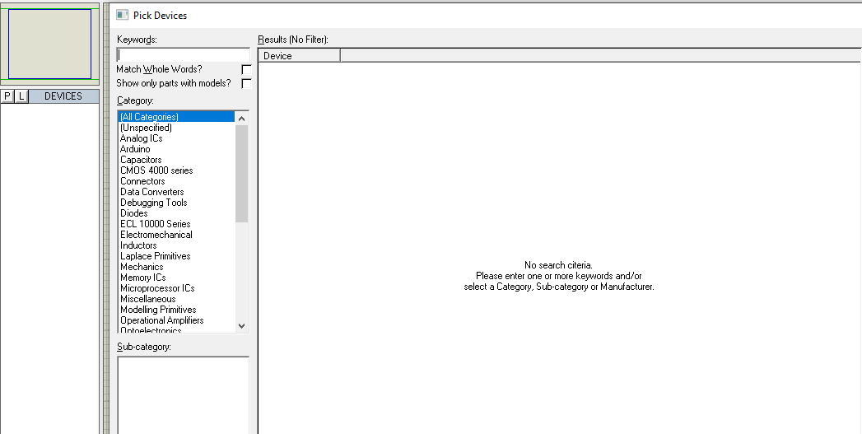
Procedure
Select the components from pick devices.

Slide 6
Required components
LPC 2148
Lithium ion battery
Panic Button
Pulse rate sensor
ESP32-cam
GSM Module
GPS Module

Slide 7
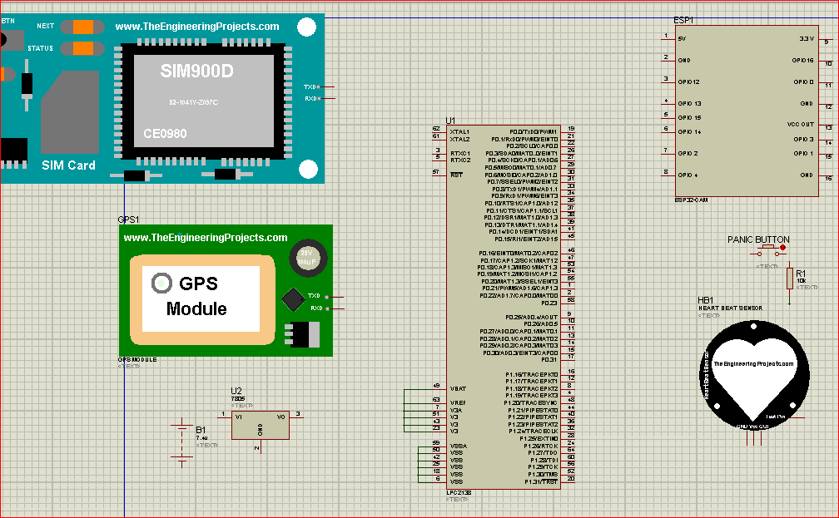

Slide 8
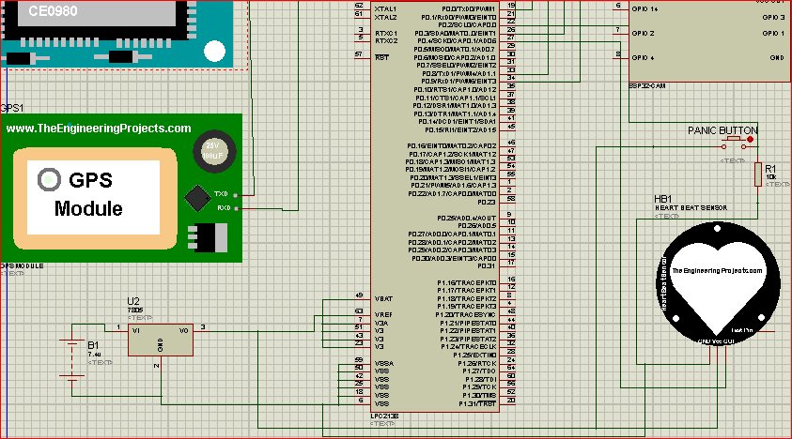
Connections with Pulse rate sensor and Panic button

Slide 9
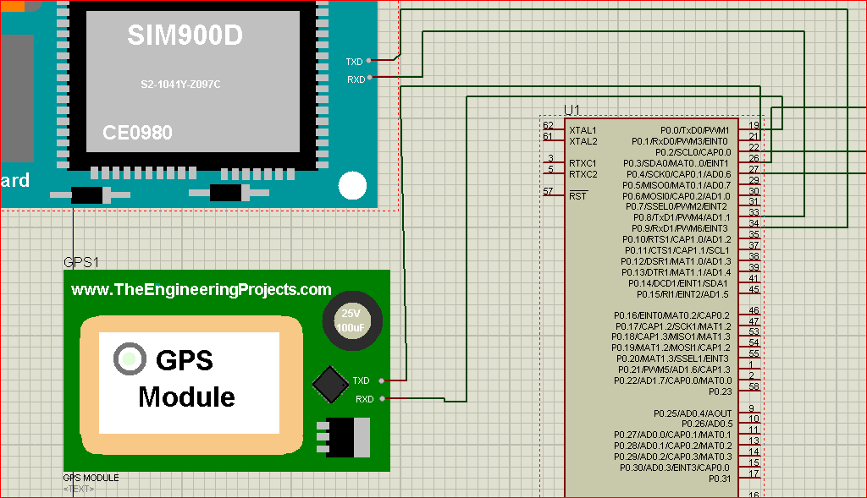
Connections of GSM and GPS
UART communication is used for connections with GSM and GPS.
GPS: P0.0-RXD
P0.1-TXD
GSM:P0.8-RXD
P0.9-TXD

Slide 10
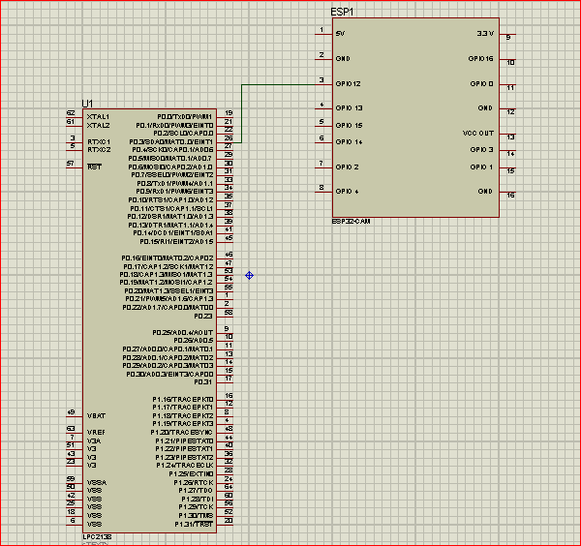
Connections with ESP32
P0.3 is connected with esp32-cam which is used to take an images of attacker , location and situation.

Slide 11
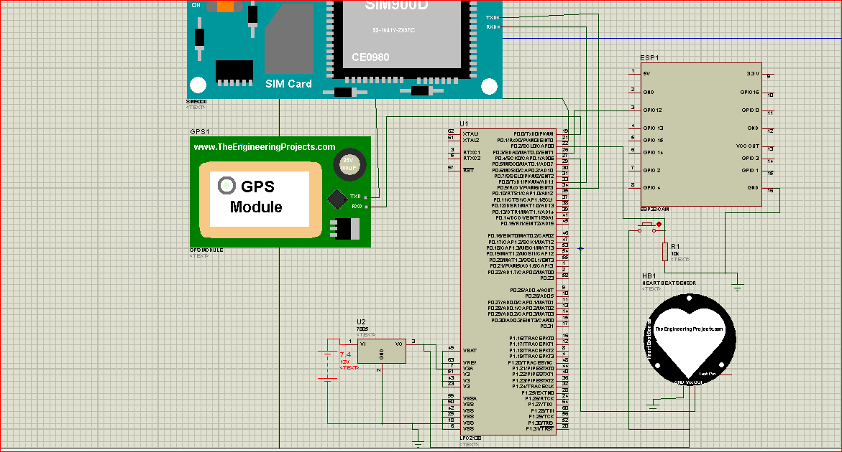

Slide 12
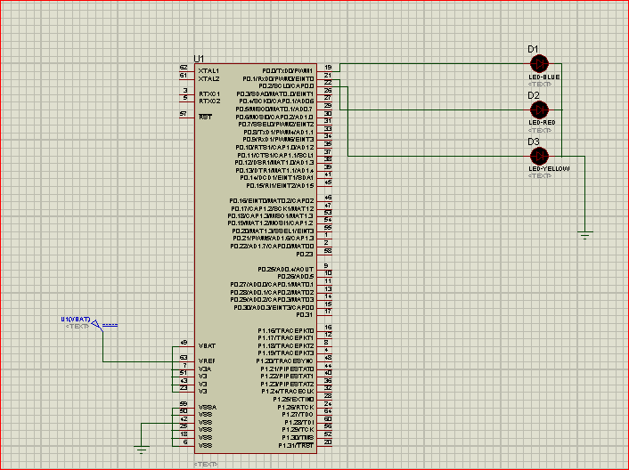
Example : Three led blinking

Slide 13
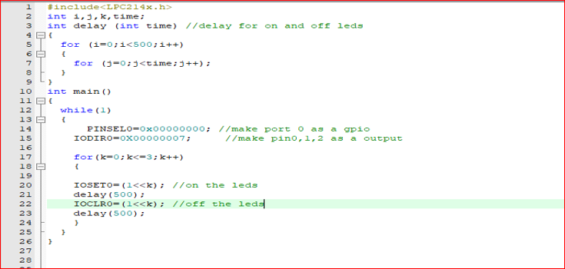
Code

Slide 14
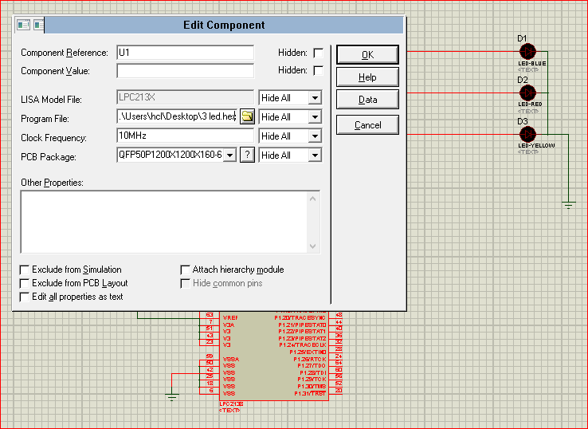

Slide 15
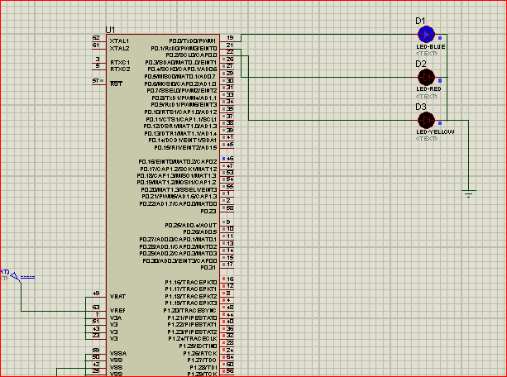
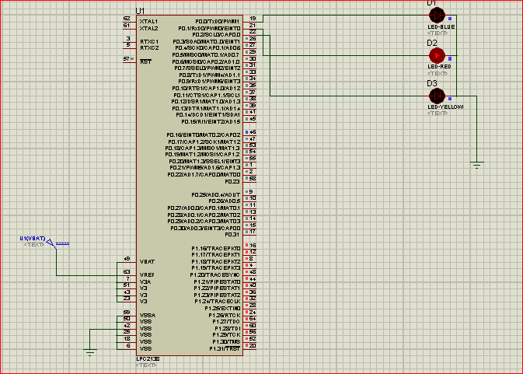
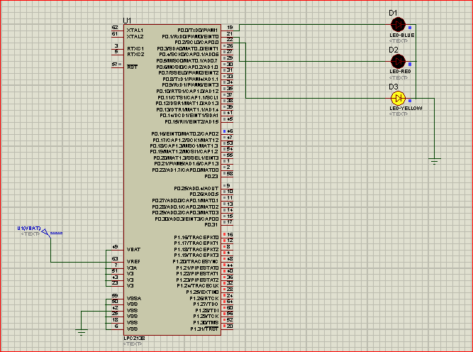
Results

Slide 16
References
Proteus.(2020).proteus download. https://www.labcenter.com/downloads/
Tejonidhi.M.R.,Dyana. M.K.Aishwarya, Nagamma.H., Chaithara.K.S. (2019),IOT based smart secuirty gadget for women’s safety, International Conference on Advance in Information Technology. https://ieeexplore.ieee.org/document/8987242
TEP technopreneur.(2020).Introduction to proteus. https://www.theengineeringprojects.com/2020/01/introduction-to-proteus.

